Slide 1
Kitty Robot

Slide 3
Abstract
Less than half the Earth's landmass is accessible to existing wheeled and tracked vehicles. Our mission is to develop a rough-terrain robot that captures the mobility, autonomy, and speed of living creatures. Kitty will travel in outdoor terrain that is too steep, rutted, rocky, wet, muddy, and snowy land which clutter limit the utility of wheeled vehicles. Kitty Robot is aimed to be a dynamically stable quadruped robot with sophisticated computing, and power systems, advanced actuators and dynamic controls.

Slide 4
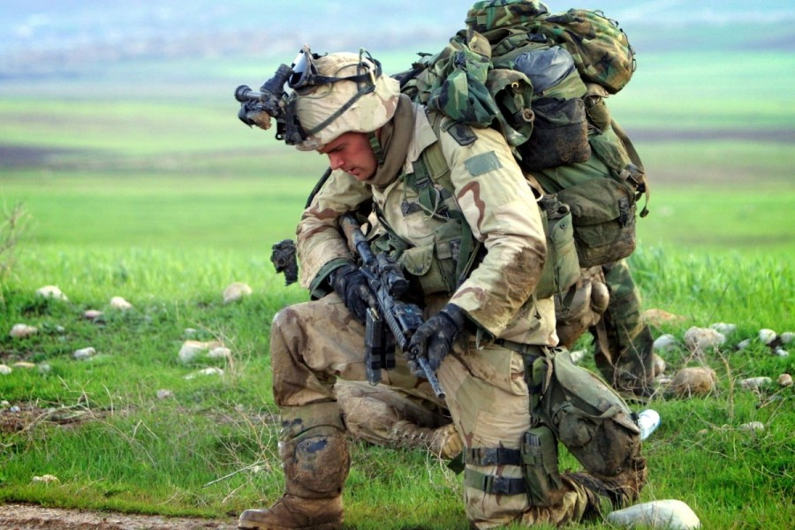
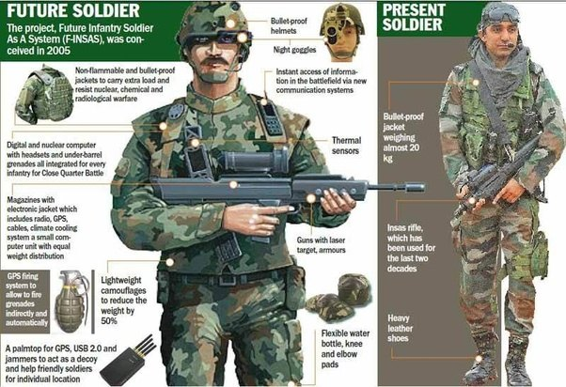
Problems faced by Soldiers
A single Soldier carries the following components during a Combat mission Bulletproof Vest, Heavy Leather Shoes, Medicines, Food, INSAS and ammunition.
Average weight carried by a Soldier during Combat/Patrolling is 40 Kg.
For Short missions, the whole gear weighs nearly 58 Kg.
Due to the heavy weight, back pain and slow movement of team is a common problem.
Also weight decreases the amount of food and ammunition that can be carried in a single deployment, so supplies are to be provided to them again.
Providing Backup Supplies and Care packages to soldiers increases the risk of life for Backup team.
Surveillance in rough terrains(which cover most part of Himalayan Range), is tough and dangerous for soldiers.

Slide 5
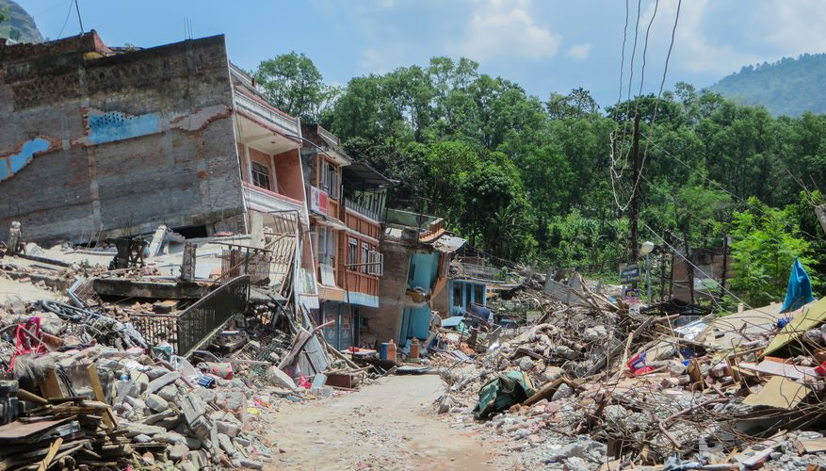
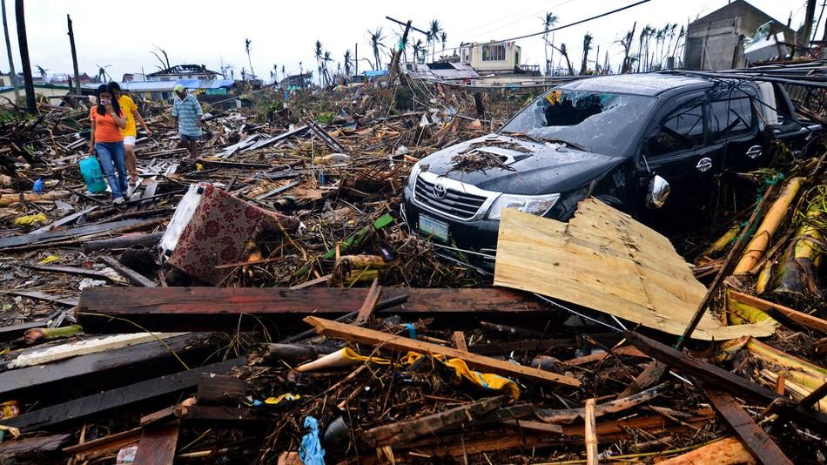
Delivery of Medicines, food and other supplies during natural disasters is difficult.
Locating Human struck in different areas during natural disasters.

Slide 6
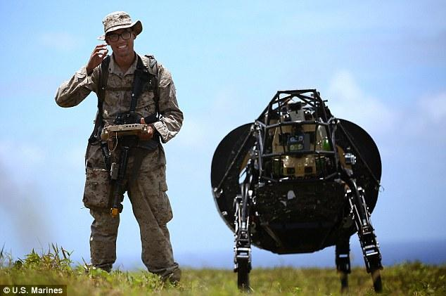
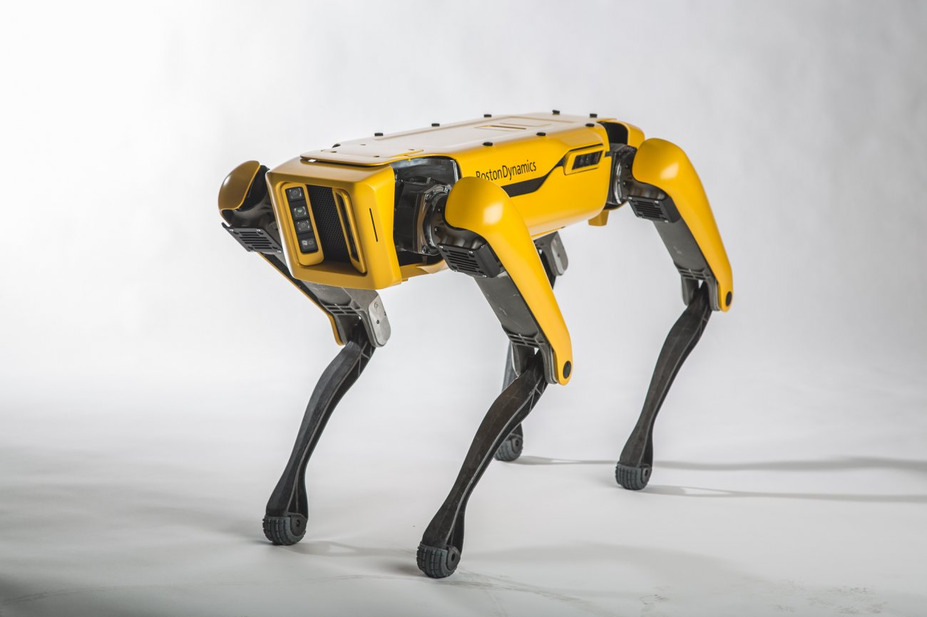
Previous Work
Comparison with wheeled robots
Big Dog
Works on engine so very noisy.
Due to this, idea was dropped DARPA
ADVANTAGE- Able to operate in uneven Terrain.
DISADVANTAGE- Inefficient
Spotimini
Works for around 40 mins on single charge.
LESS runtime.

Slide 7
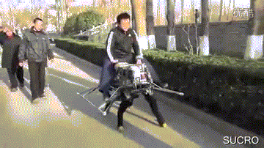
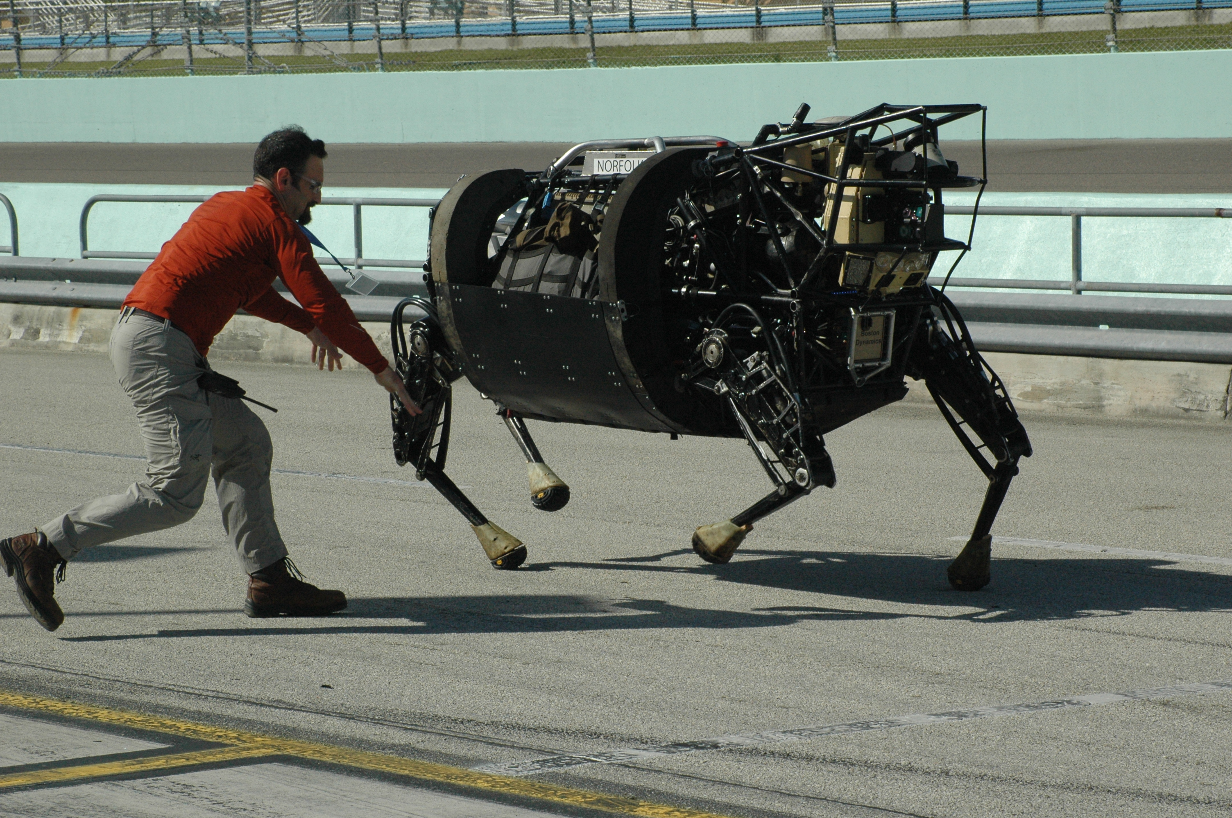
Da Gou China LS3 DARPA

Slide 8
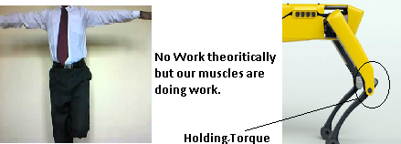
But why Quadruped robots less efficient?
So what can be the solution?
We require an actuator which would have Self locking property.

Slide 9
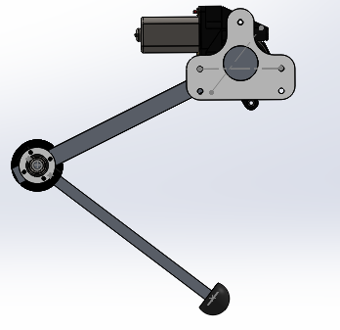

Slide 10
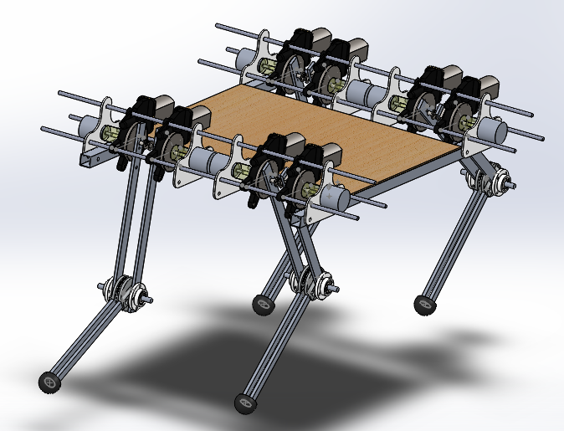
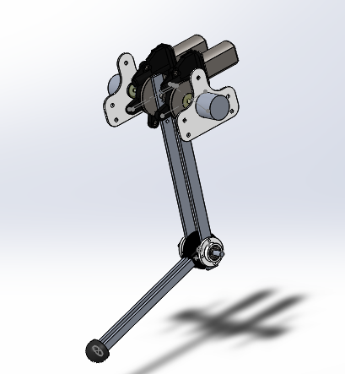
CAD Design

Slide 11
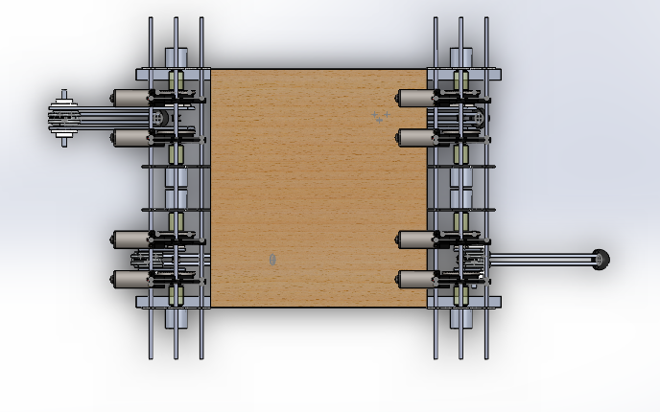
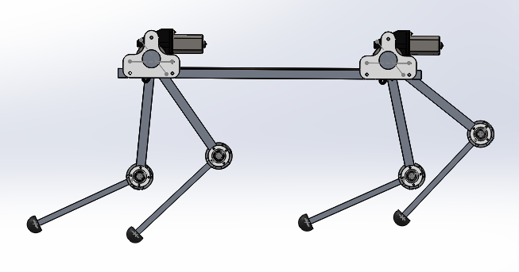
CAD Design

Slide 12
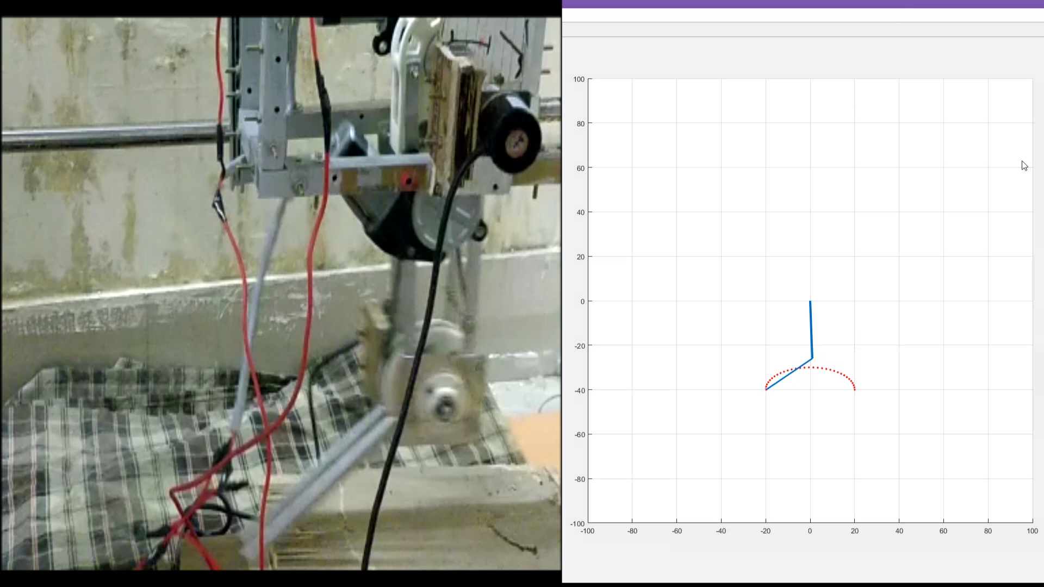
Single Leg Simulation

Slide 13
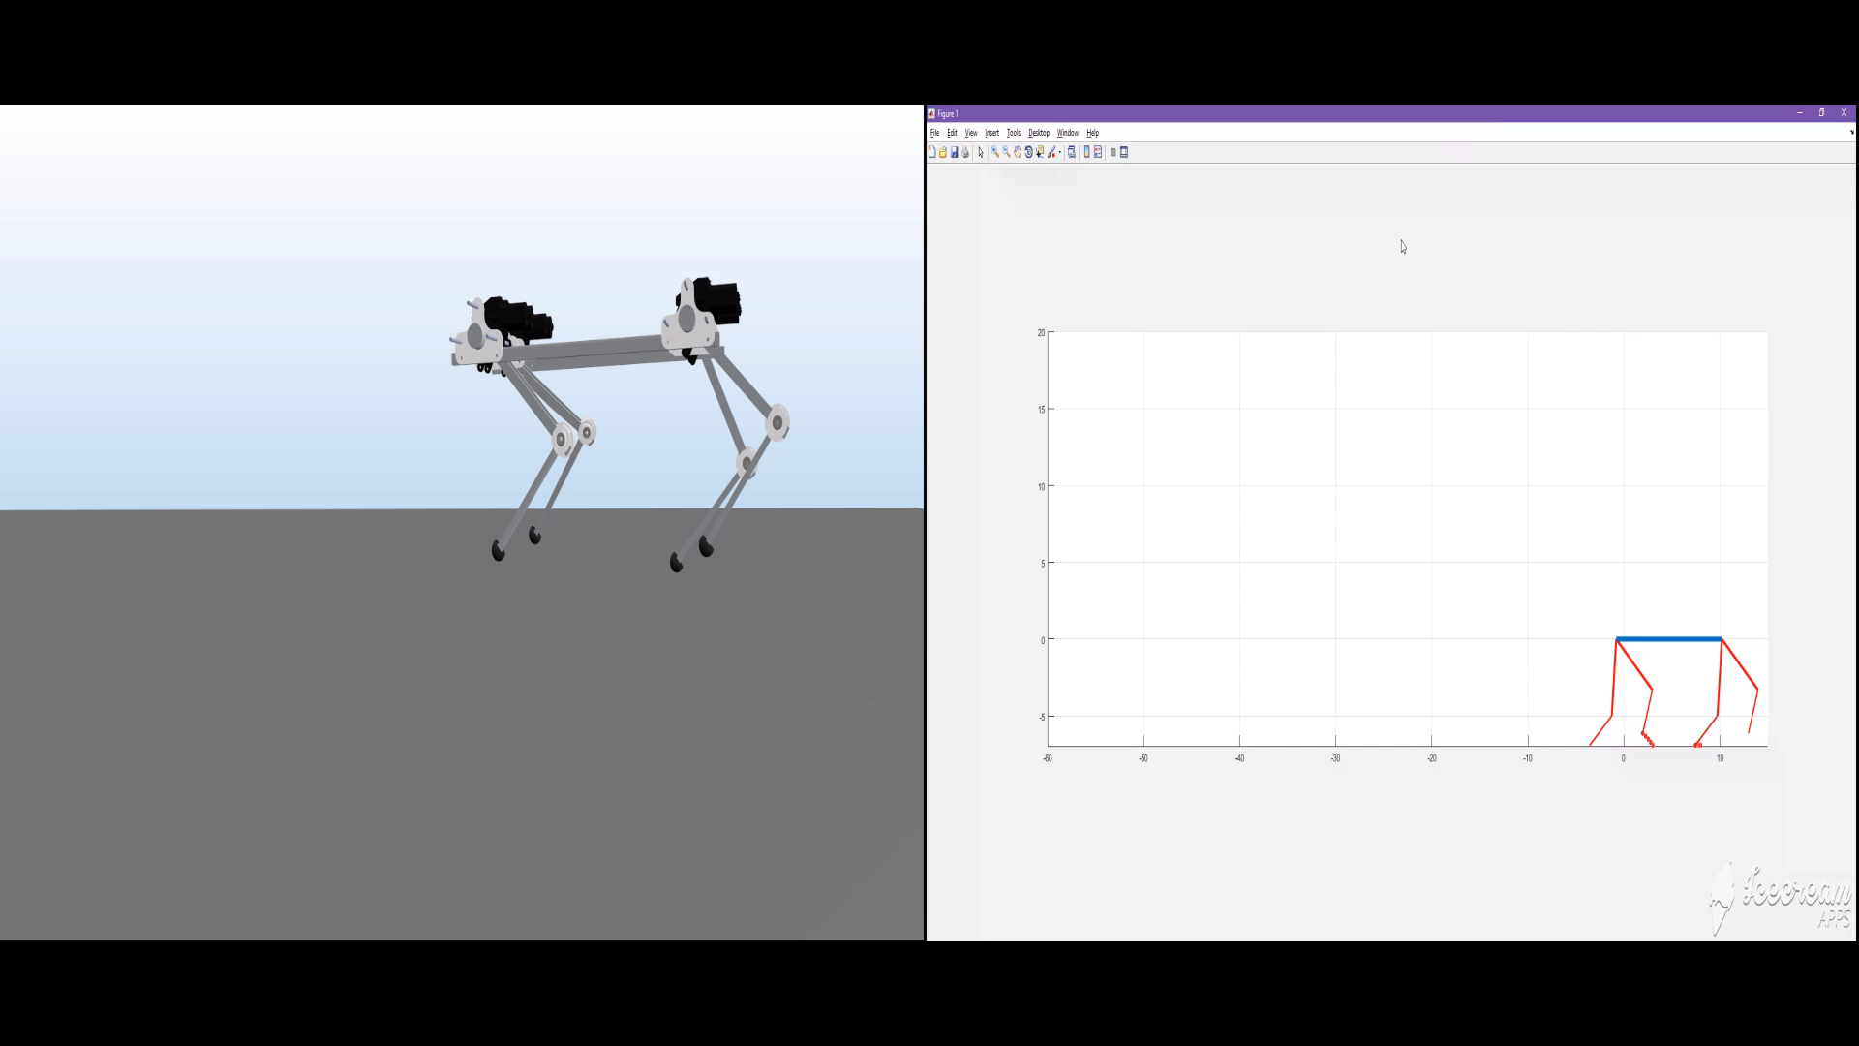
Robot Matlab and ADAMS Simulation

Slide 14
Working Prototype of Single Leg with Load Bearing

Slide 15
Future Goals
Obtain Pace, Gallop and Canter Gait cycle for faster movement.
Increase the Payload Capacity of the Robot.
Provide 3 DOF to each leg providing more flexibility to the robot for movement in uneven areas.
Using Computer Vision for Obstacle detection, human recognition and corresponding Path planning.

Slide 16
Estimated Budget
The Design of Kitty is made with the main focus on lightweight, high endurance and low cost. Most of the components used in the bot are easily accessible. The current estimated cost of Kitty is around 53000 INR. The cost can be significantly reduced when the bot is manufactured commercially on a large scale. It is cheap, easy to reproduce, robust, and safe to handle. This makes it an excellent tool for research of multi-segment legs in quadruped robots.
Component | Cost(INR) | Total
Worm Geared Motor (x8) | 1552 | 12417
LiPo Battery(x5) | 1309 | 6545
Rotary Encoder(x8) | 1590 | 12720
Arduino Uno(x5) | 425 | 2125
Cytron Motor Driver(x4) | 1890 | 7560
PCB (x1) | 1000 | 1000
MPU6050 (x2) | 150 | 300
Ultrasonic Sensor (x2) | 197 | 394
Jumper Wires | 5 | 150
Square Channels (x20ft) | 20 | 400
Aluminum Links (x12ft) | 20 | 320
Chain & Sprocket (x4) | 400 | 1600
3D Printed Parts (x4) | 1500 | 6000
Miscellaneous | 800 | 1000
Total |  | 52531

